Slide 1

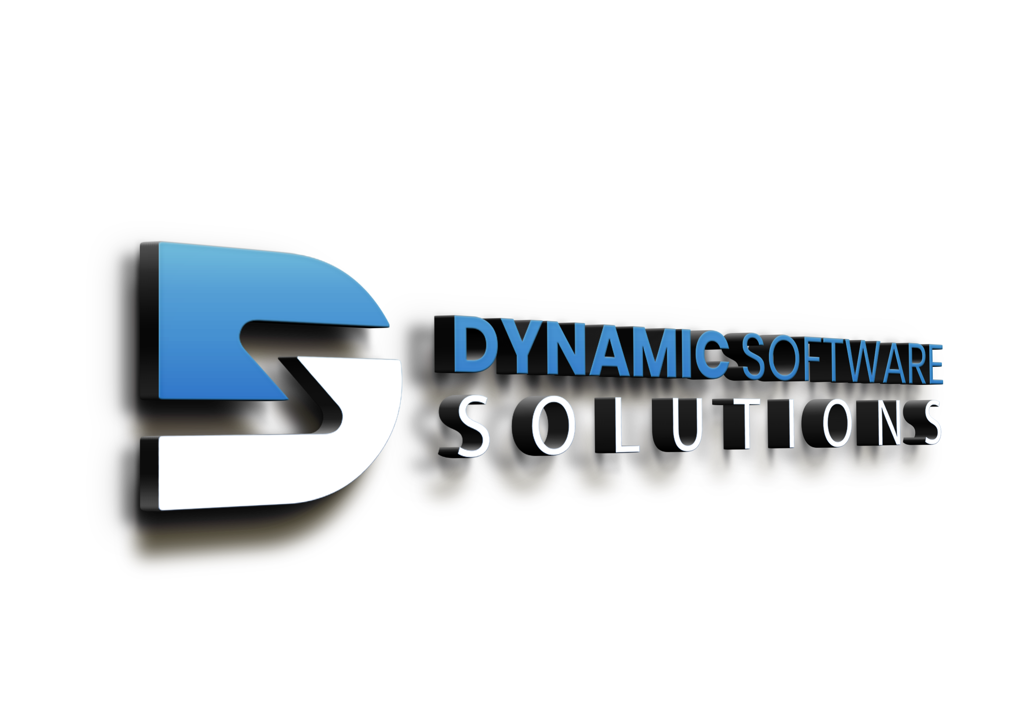

Elevate care delivery with Microsoft Dragon Copilot
A unified AI assistant built for healthcare where clinical workflows meet intelligent automation

Slide 2

Administrative complexity is undermining care and clinicians need relief
Documentation, chart navigation, prior authorizations, and patient messaging consume significant portions of clinicians’ days. These tasks lead to fatigue, reduced patient face time, and lost revenue.
43.2%
52.2%
31 days
of physicians reported experiencing at least one sign of burnout.¹
of physicians report a 57.8-hour work week, with 30.2 hours spent on indirect patient care and administrative tasks.¹
The average wait time for new patients is 31 days, and up to 41.8 days for specialties, leading to patient leakage.²
These challenges, coupled with an aging workforce, are leading to a projected workforce shortage that healthcare organizations must address.
“Doctors work fewer hours, but the EHR still follows them home,” American Medical Association, 2025.
“2025 Survey of Physician Appointment Wait Times and Medicare and Medicaid Acceptance Rates,” AMN Healthcare, 2025.
2
BACK
NEXT

Slide 3

Dragon Copilot offers an AI-driven workspace to solve these challenges
These capabilities are designed for measurable outcomes, reducing administrative burden, improving documentation quality, accelerating decision-making, and strengthening clinician and patient experiences across the care lifecycle.
Let’s take a closer look at how.
Dragon Copilot is an AI clinical assistant that unifies natural language dictation, ambient speech technology, and AI plug-ins and agents to empower healthcare teams. Built on the secure, scalable Microsoft architecture, Dragon Copilot delivers enterprise-grade reliability, role-based access controls, and multifactor authentication, so organizations can confidently deploy AI at scale.
With this intelligent workspace, your organization can:
Streamline documentation with new levels of customization.
Surface information without leaving your workflows.
Automate tasks with a single click.
3
BACK
NEXT

Slide 4

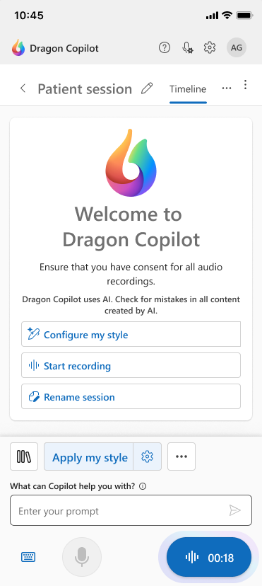
Streamline documentation with new levels of customization
Lighten the documentation load so clinicians can spend less time clicking and more time on what matters most—patient care. By streamlining charting, notes, and flowsheets, it reduces rework and documentation time to improve work-life balance, lower cognitive load, and minimize burnout.
Key capabilities:
Ambient conversation capture with multiparty, multilingual support
Automatic note conversion into comprehensive specialty notes
Custom style, formatting, and templates automatically applied or on-demand
Prompt and text library to save time with frequently used shortcuts
AI note assist to edit, query, summarize, and create content
ED MDM note style to capture thought process and patient journey
Specialty-specific AI models to precisely capture specialty content
4
BACK
NEXT

Slide 5
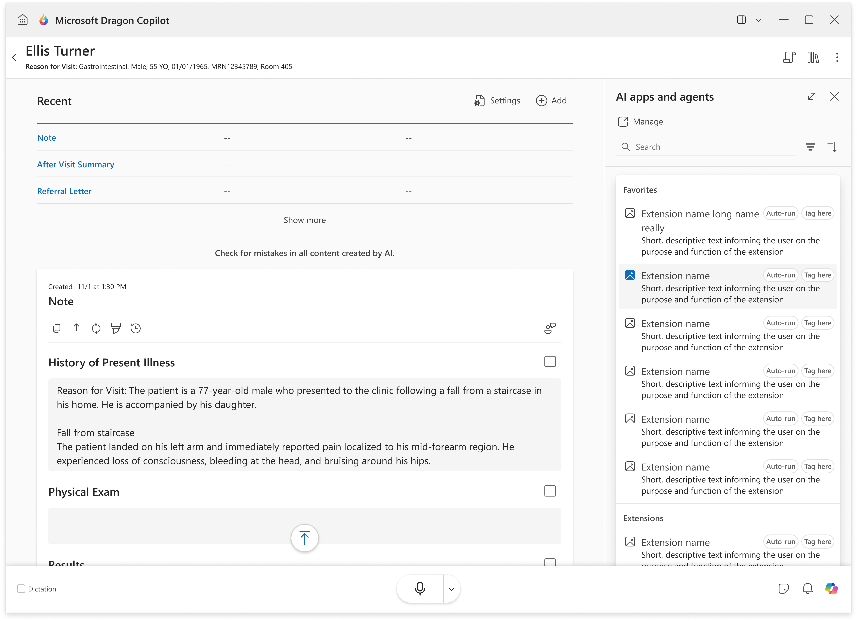
Surface information without leaving the workflow
Clinicians get the right information at the right moment without breaking the workflow, so they can get what they need quickly and stay focused and confident. Dragon Copilot intelligently consolidates patient data and clinical insights from fragmented systems into a single view, reducing the risk of missing critical details and the frustration of searching across multiple platforms, enhancing care quality and operational efficiency.
Key capabilities:
AI prompting to query notes with natural language
Information assist delivers a range of medical information from trustworthy, vetted healthcare-specific resources directly in the app
Coaching that provides users with suggestions to improve encounter recordings
Microsoft Fabric and Dragon Copilot integration gives access to slice and dice your data for comprehensive insights
Analytics to see user productivity, adoption, efficiency, and dictation quality
5
BACK
NEXT

Slide 6
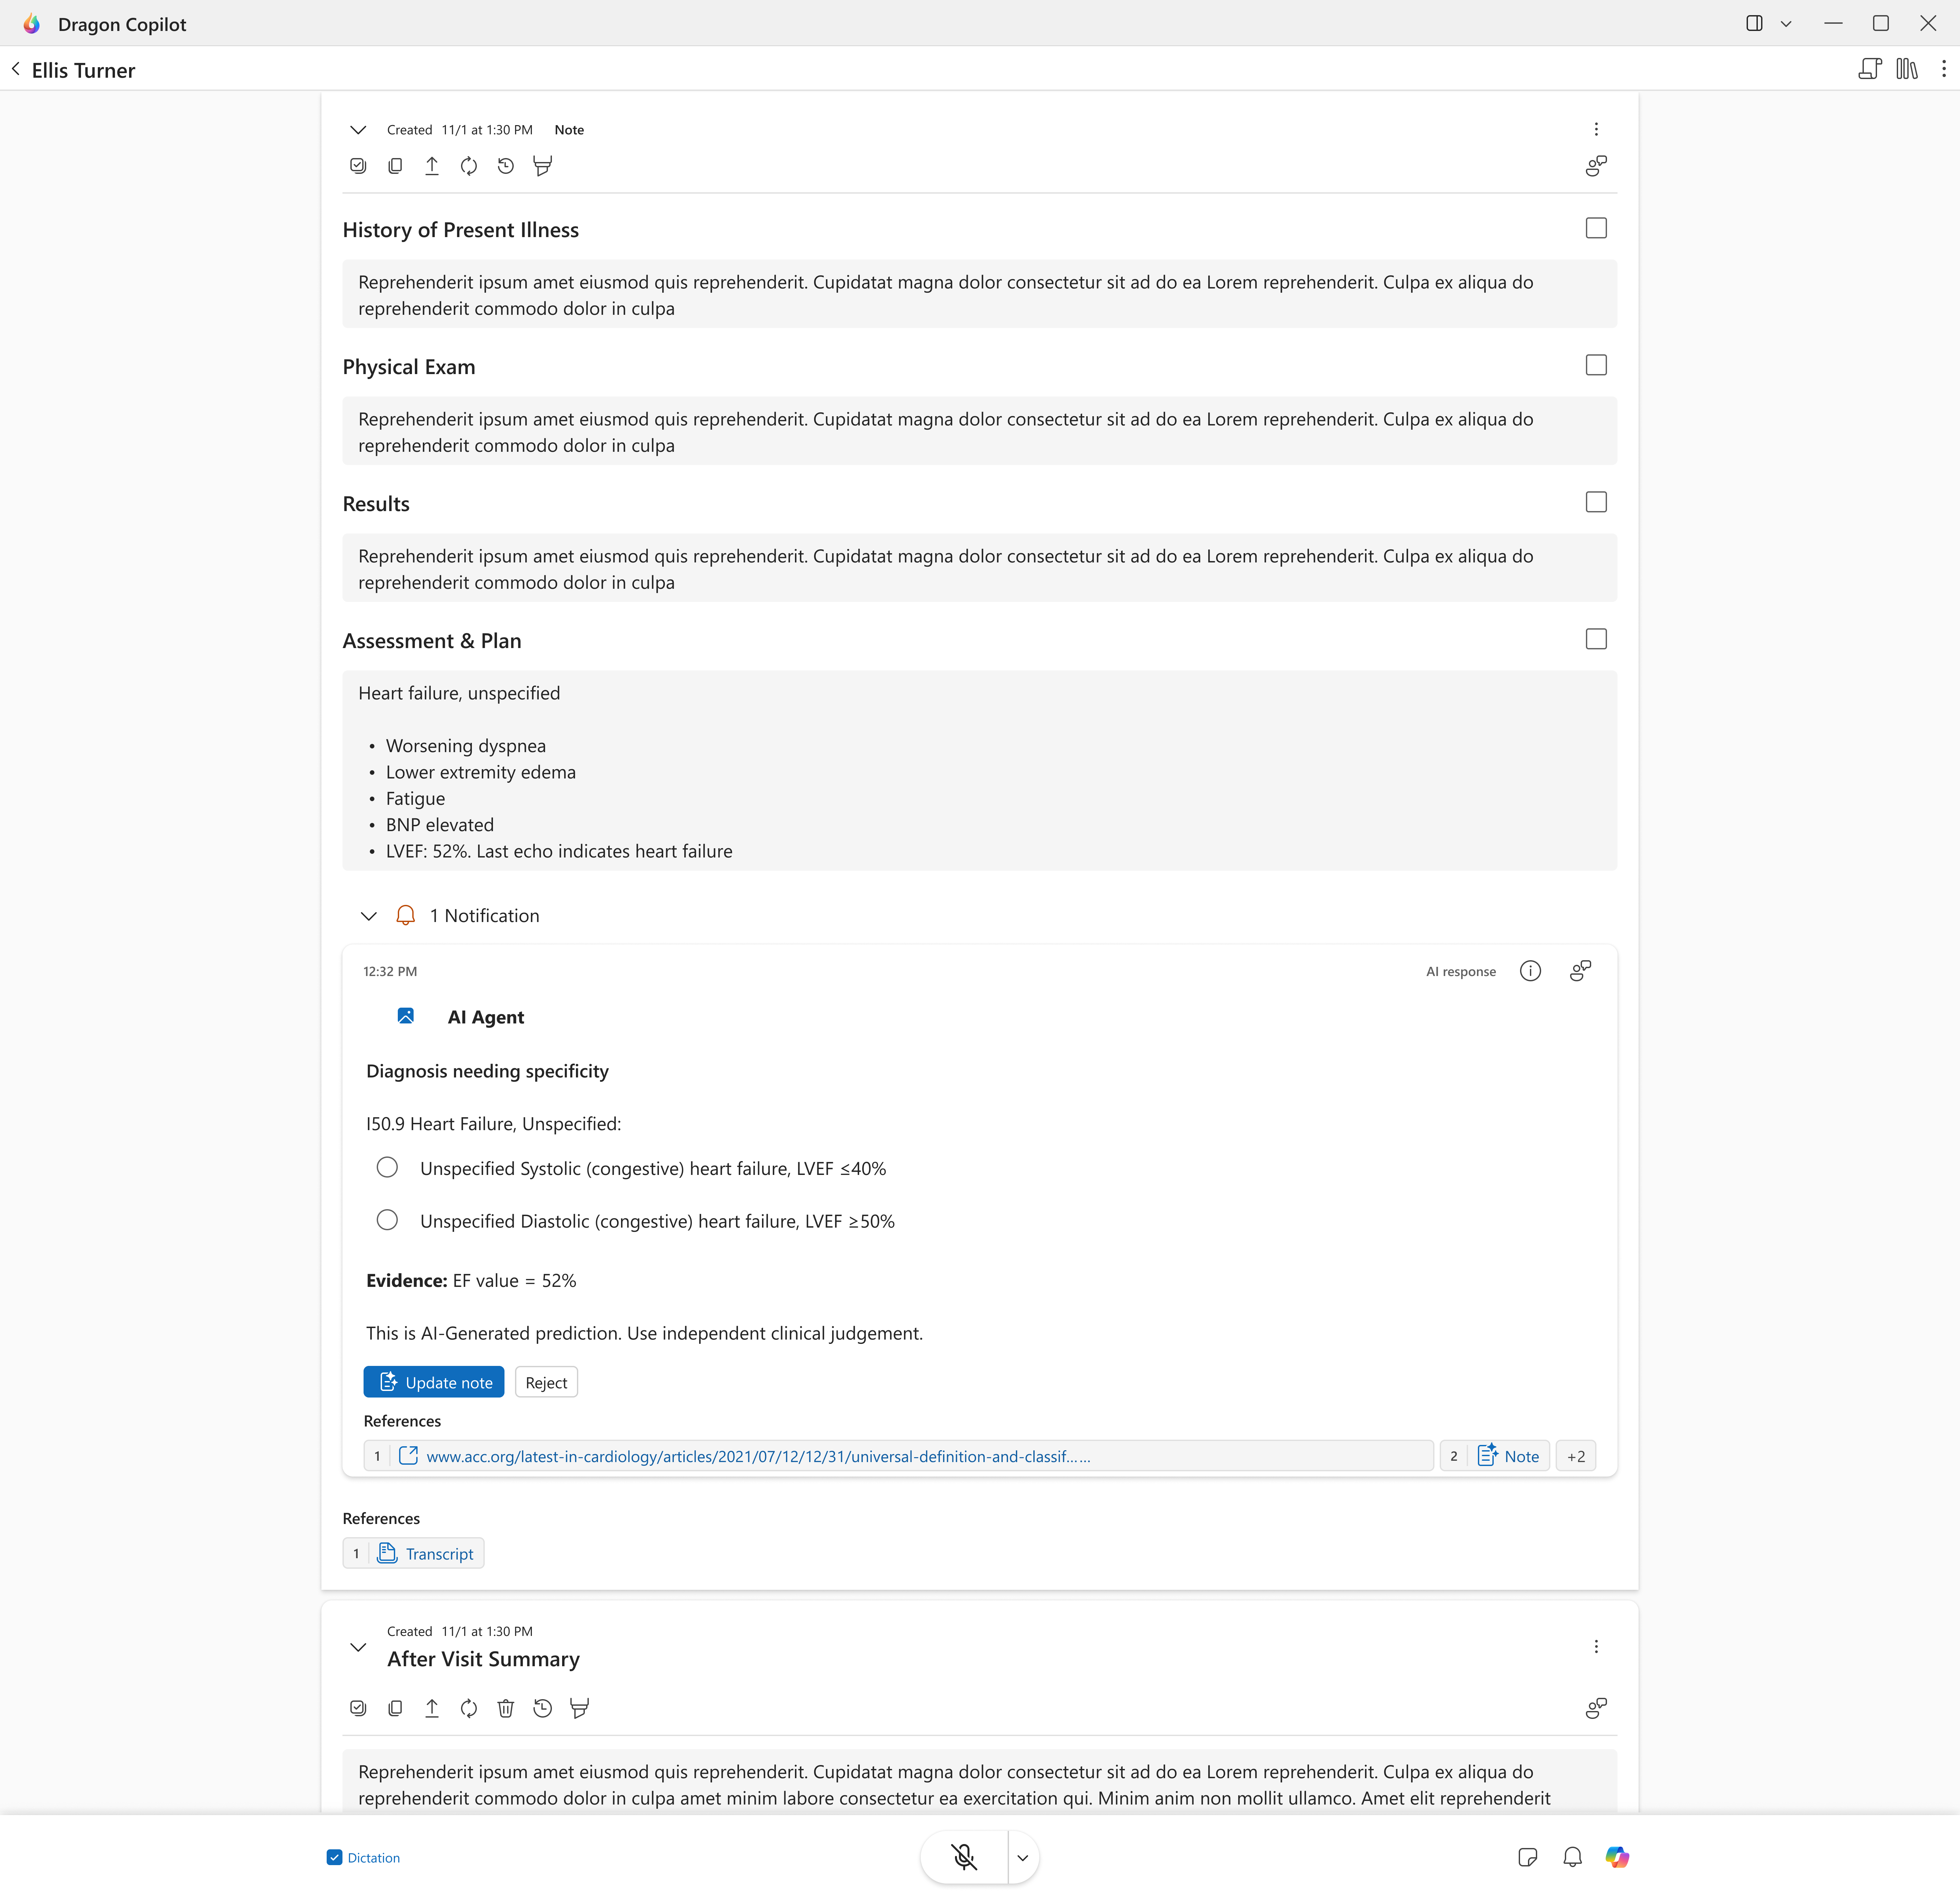
Automate tasks with a single click
Automate routine tasks and minimize toggles to streamline workflows. From persona-specific note types and automated referral letters and after-visit summaries to summaries of prior radiology reports, Dragon Copilot takes on the heavy lifting, so care teams don’t have to. This automation improves clinician well-being and enhances the overall patient experience by reducing manual effort and speeding up routine steps.
Key capabilities:
Orders captured from the conversation and placed in EHR order list
Summarized notes with an encounter synopsis and key facts
After-visit summaries created from the transcript with personalized content
Referral letters created from the transcript with one click
Summarized evidence of each diagnosis to validate medical information in the note
Coding suggestions for use on-demand or automatically applied to the note
6
BACK
NEXT

Slide 7


Cooper University Healthcare enhances patient care with Dragon Copilot
Clinicians are able to talk naturally with patients, and the system is able to draft a structured note instantly. That saves a lot of time, saves a lot of mental energy.”
Clinicians and advanced practice providers at Cooper University Healthcare in Camden, New Jersey were facing a growing crisis: they were spending one to two hours after their shifts completing documentation, reviewing in-basket messages, and finalizing notes leading to burnout. This “pajama time” was eroding work-life balance and diminishing the joy of practicing medicine.
The team turned to Dragon Copilot with a clear vision: reduce administrative burden and give clinicians back their time. The impact they realized was immediate and profound.
—Snehal Gandi MD, VP and Chief Medical Information Officer, Cooper University Healthcare
Clinicians reduce time spent on documentation by 41.5 minutes per patient.
Saves upwards of an hour per day* on documentation time with some clinicians adding extra patients to their schedules.
They have also been able to engage with patients more meaningfully with more comprehensive notes, improved communication, and increased patient satisfaction.
*Microsoft survey of 40 users across Cooper facilities, September-November 2025.
7
Read the full story.
BACK
NEXT

Slide 8


Vail Health boosts clinician productivity with the power of Dragon Copilot
Clinicians at Vail Health dealt with increasing demands of manual documentation that took their energy and time away from patients. As a result, there was a desire to reduce these administrative burdens and streamline their workflows for more efficiency.
Dragon Copilot transformed their clinician workflow to dramatically increase efficiency and allow clinicians to complete notes quickly and accurately. With advanced customization options for assessment and plan templates, clinicians can tailor documentation to meet their specific needs, ensuring all necessary elements for billing and coding are included without sacrificing quality or speed.
The improvements from AI assistance:
Dragon Copilot has allowed me to get the most difficult parts of my note done quickly. I’m amazed at how it is able to capture the most relevant data for the visit, and the AI is able to only pick up the relevant history for the most part. I’m amazed at how it can organize advice that I’m giving throughout the encounter with a family and organize it into a pretty concise summary at the end of my visit.”
—Janet Engle MD, Pediatrician, Vail Health
Enhance work-life balance by freeing up personal time.
Empower healthcare teams to focus more on patient care.
Support better outcomes and satisfaction for both clinicians and patients.
8
BACK
NEXT
Read the full story.

Slide 9

Unlock the next generation of clinical efficiency
Together, Dynamic Software Solutions and Microsoft bring a unified approach to solving the complex needs healthcare organizations face today, powered by trusted, secure, and scalable technology built for healthcare. Organizations can safeguard data, meet evolving regulatory requirements, and provide centralized administration for enterprise-wide control by taking advantage of a solution built on the Microsoft security and trust principles.
As healthcare evolves, intelligent automation will play a critical role in ensuring organizations meet growing demands with resilience, efficiency, and compassion. Dragon Copilot delivers the solution needed to meet these needs and drive measurables results by reducing administrative burden, accelerating decision-making, and enhancing clinician well-being and patient experience to strengthen operational and financial performance across the care lifecycle.
Ready to explore Dragon Copilot for your healthcare organization?
Contact Us
Online Demo
Copilot Solutions
9
BACK

